Slide 1

Data Hiding Tool using Cryptography and Steganography -Project Exhibition II [Group _33]
Team Members:
Yogesh Kumar 19BCY10026
Suryakamal Jain 19BCY10071
Parth Chauhan 19BCY10083
Aditya Chouhan 19BCY10085
Guided By :
Gyan Prakash Tiwari

Slide 2

INTRODUCTION
Data Hiding - It is the practice of protecting digital information from unauthorized access, or theft throughout its entire lifecycle by hiding it using different means of techniques.
Some of them are cryptography, steganography, hashing, tokenization and many more, that protects and hide data across all applications and platforms.
Our project will combine two of the above-mentioned techniques i.e., cryptography and steganography.

Slide 3

Why and what is Cryptography ?
Cryptography — It is the science of converting data into an unreadable form using different techniques that allow only the sender and intended recipient of a message to view its contents.
When transmitting electronic data, the most common use of cryptography is to encrypt and decrypt email and other plain-text messages.
We are using AES -256 encryption algorithms which a type of symmetrical block algorithm , which uses a single key for both encryption as well decryption.

Slide 4

Steganography
Steganography — It is the science of hiding information. In cryptography we make data unreadable by a third party whereas the goal of steganography is to hide the data to avoid any suspicion from a third party.
In steganography we hide some confidential files into an ordinary file or non- secret file in order to avoid detection.
It is a process of embedding a secret piece of data within a text, picture, audio or video.
We are using image steganography.

Slide 5

Literature Review
Year | Author(s) | Name | Description
2015 | D. Debnath et al. | "An Advanced Image Encryption Standard Providing Dual Security: Encryption Using Hill Cipher and RGB Image Steganography" | Authors proposed a new method in which both steganography and cryptography is used. Data is first encrypted using hill ciphers and then embedded into RGB cover image.
2014 | D.E.M. Ahmed and 0.0. Khalifa. | "Robust and Secure Image Steganography Based on Elliptic Curve Cryptography''. | Their research work focuses on LSB image steganography along with elliptic curve cryptography (ECC). Secret information is first encrypted with the help of ECC and then ciphered information is embedded into cover image.
2014 | N.A. Al-Otaibi, and A.A. Gutub | “2-Leyer Security System for Hiding Sensitive Text Data on Personal Computers". | They designed a new system based on two layers of steganography and cryptography. Steganography layer use multiple LSB bit embedding and cryptography layer use AES algorithm for data 15 encryption. Experimental results show that 1LSB and 2LSB embedding have good stego image quality than higher bit embedding.

Slide 6

2014 | M. R. Islam et al. | “An efficient filtering based approach improving LSB image steganography using status bit along with AES cryptography” | Authors proposed a new improved version of LSB steganography based on efficient filtering using status bit. AES cryptography algorithm is applied to gain higher level security to hidden secret data. Bitmap images are used as cover images. Proposed system has high PSNR and data hiding capacity.
2014 | S. Krishnagopal et al. | “Image Encryption and Steganography Using Chaotic Maps with a Double Key Protection". | In this proposed work Chaos based cryptography is used with steganography. Chaotic logistic and cat map are used as the base for their image encryption algorithm. Results demonstrate that proposed system has 0.981 SSIM index value and 47.71 dB PSNR.

Slide 7


Problem statement/Objective
Problem — There are many tools available online which uses cryptography and steganography separately but there is hardly any open-source tool which uses a combination of both of these .
So, our objective is to create a tool that does not only encrypts data but conceal it as well. This will enhance the level of security to the user’s data.
As even if someone gathers the data, firstly he will have to identify that something discrete is hidden inside it and even if he does this then he will have to decrypt it as well to get the original confidential data so this whole process will be very difficult to execute, and time taken.

Slide 8

Proposed work
As mentioned earlier, that we will combine Cryptography with Steganography.
The user will be asked to enter the data then after obtaining the data it will be encrypted with AES-256 algorithm after the encryption it will be concealed in an image using image Steganography.
To get the original data firstly user will be authenticated using the unique key. Then the data firstly will be extracted from the image then it will be decrypted.
To make it user friendly we will convert this into a GUI or an online tool.

Slide 9

REAL time Usage

Slide 10

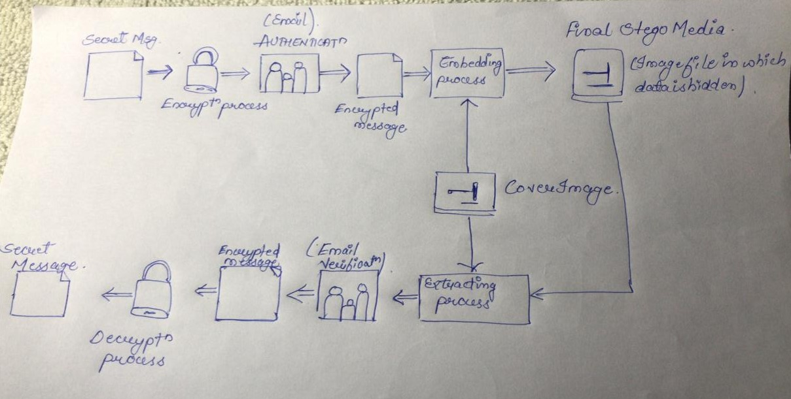
system architecture diagram

Slide 11

Modules used
MODULES​ | WOKING / EXPLANATION​
cryptography | This module of the cryptography package supports cryptographic functions like encryption and decryption.​
PIL ​ | ​it's used for different format of images.
stegano | ​It’s the python steganography module.
tkinter.filedialog​ | This module provides classes and factory functions for creating file/directory selection windows.​
smtplib,ssl​ | This module is used for sending emails using the Simple Mail Transfer Protocol (SMTP) with or without a secure encrypted protocol to connect to the SMTP server​
tkinter ​ ​ | This framework provides a simple way to create GUI elements using the widgets found in the Tk toolkit.​ ​
pycrypto | Used for AES-256 encryption in python.

Slide 12

Project timeline chart
Start
First Review
Identifying ,defining the problem and gathering Information
Demonstrating a basic structure of tool
Making a working Prototype based on information gathered
Applying the changes if required (by our mentor) and then testing the final tool .
Sept 2021
Oct 2021
1 Month
1 Month
1 Month
After identifying and defining the problem, the time plan of activities and methodology will be framed using relevant scientific methods.
Second Review
Final Project Review
Demonstrating a working prototype of our tool
Demonstrating and Display of the final tool with Project Report
Nov 2021
Dec 2021

Slide 13

References
https://docs.python.org/3/
https://www.geeksforgeeks.org/
https://github.com/
https://www.google.co.in/

Slide 14

THANK YOU

